Slide 1
Data, Batches, and Normalization
Start lab6 early as the model needs hours to be trained. Training a neural network, it;s good to understand how the process works.
Get above 50% accuracy. Run more epochs to get more accuracy even up to 90%. incrase the baych size to 64?
Nb part d ie the testing can still be done when the network is not fully trained. If time is getting late. There are compute resources as well if pc is too slow.
Or even google colab.
CSCI 4150/6050: Computer Vision
Many of the slides are from
Professor David Wingate (BYU)

Slide 2
The Three Pieces of Deep Learning
Labeled Data
  Do I have enough ground truth labels and images? And how do we feed this data into the pipeline so it is effective for learning. See week 10
A Neural Network
  What mathematical operations am I performing on the images?
A Loss Function
  How does the network know when it is doing well?

Slide 3
Understanding Data in PyTorch
There are three main classes that handle data in PyTorch:
  Dataset – Defines where the data is stored and how to get samples from the dataset. Ie labels, logic, you write this
  DataLoader – Samples the data and describes how much data to load at a time. Baseline class we don’t usually override
  Transforms – Modifies the data before it is sent through the network.

Slide 4
Datasets
The Dataset class in PyTorch describes all the needed information to extract labeled samples from your dataset for training.
It requires defining three functions:
  __init__ - Stores needed information about where image directories are located, image labels are stored, etc.
  __len__ - Tells how many examples are in a dataset
  __getitem__ - Extracts the nth element of a dataset

Slide 5


Common Image Dataset Setups
Json is most common, we have the images then to find its label ust look in the json file, match the string ie name, then look if t is cat, dog or bird.ij
Folder-based Labeling
Naming-based Labeling
Cat_Images
image001_cat.jpg
Dog_Images
image002_dog.jpg
Bird_Images
image003_bird.jpg
JSON-based Labeling
image001.jpg
image001.jpg: “Cat”
image002.jpg: “Dog”
image003.jpg: “Bird”
labels.json
image002.jpg
image003.jpg

Slide 6
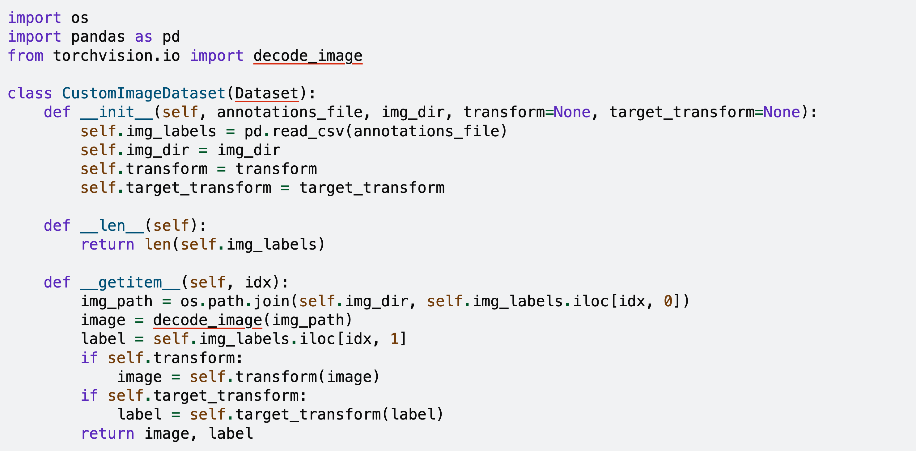
Example Dataset
https://docs.pytorch.org/tutorials/beginner/basics/data_tutorial.html

Slide 7
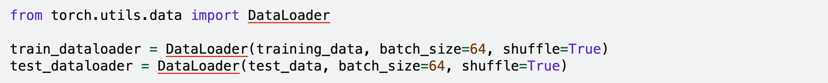
Data Loaders
The DataLoader class wraps around the Dataset class and handles sending training examples to the neural network.
It has nice convenience functions like shuffling the dataset and pulling out examples in batches.
Batch size is the number of images we want at once, shuffle means randon choossing..
With for loops instead of the init and other functions we defined, we cannto easily shuffle the dataset. Ie when the 64 random indexes are chosen, the getitem function
Is then used to call labels for each.
Question, what happens if the last batch is not up to 64, how does the dataloader handle it.

Slide 8
Why do we want batches?
Why don’t we just load one image at a time instead of batches? It;s harder to learn because per document you cannot reference others in the dataset ie how is the cat differejnt from the cat?
The loss is very high as it optimises for the current example but forgets the previous. But in a batch it has to optimise the weights and differences for the present images.
Ideal World: We load the entire dataset into memory and optimize on it at the same time to increase speed of convergence.
  Problem: This is usually impossible given memory constraints.
Next best thing: Load in as much of the dataset you can (batches).
  In PyTorch, data is loaded as [batch, channels, rows, cols]

Slide 9
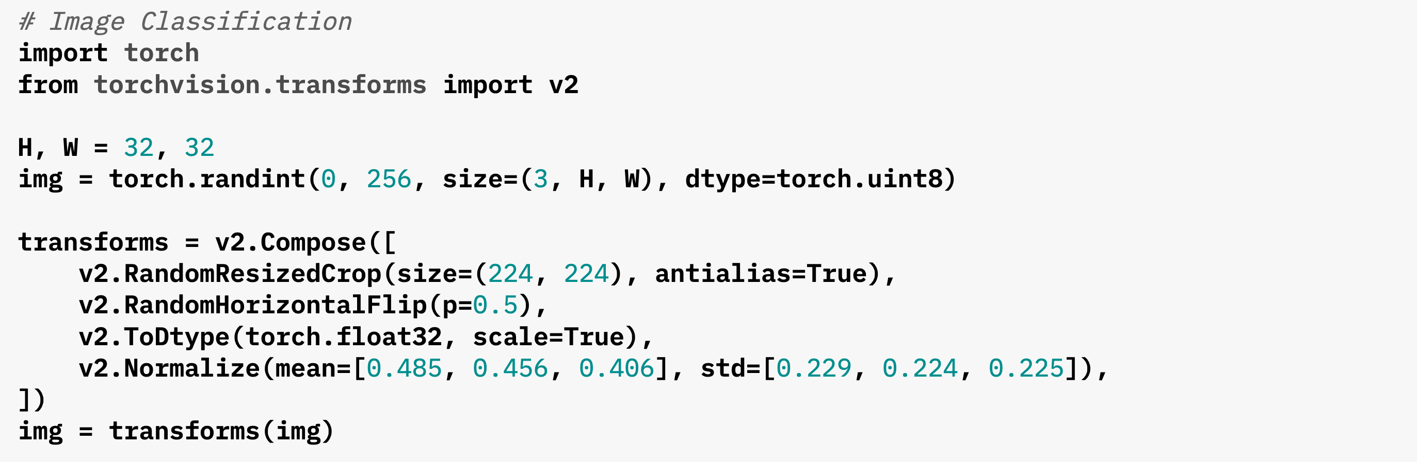
Transformations
Transformations guarantee that the input images are a consistent size and numerical representation.
Transformations can also be used to implement data augmentation.
The normalize mean here is not 0.5 for the different channels ut those numbers because they take the average of the image pixels instead of just choosing 0.5. so images seem to be darker.

Slide 10
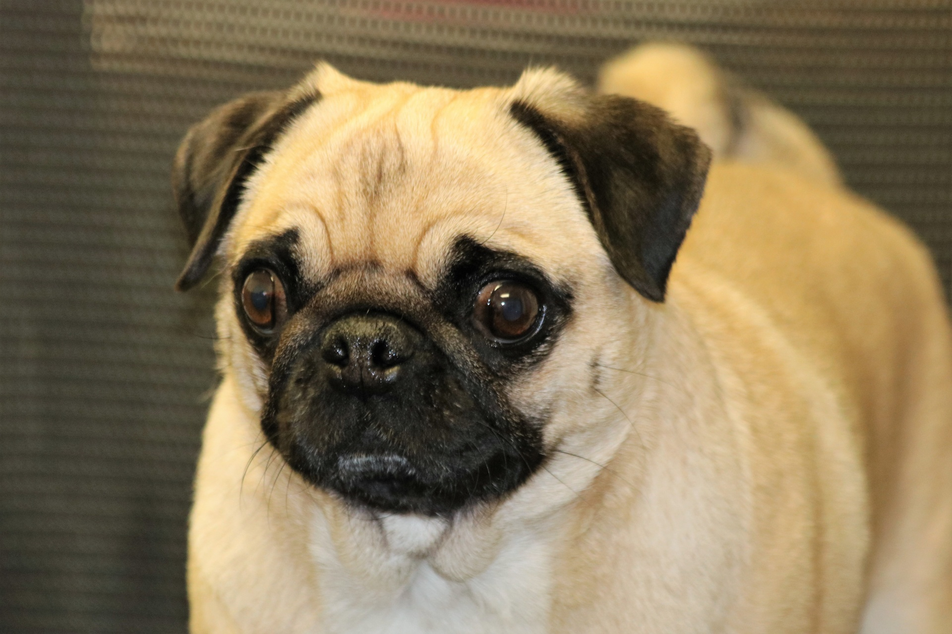
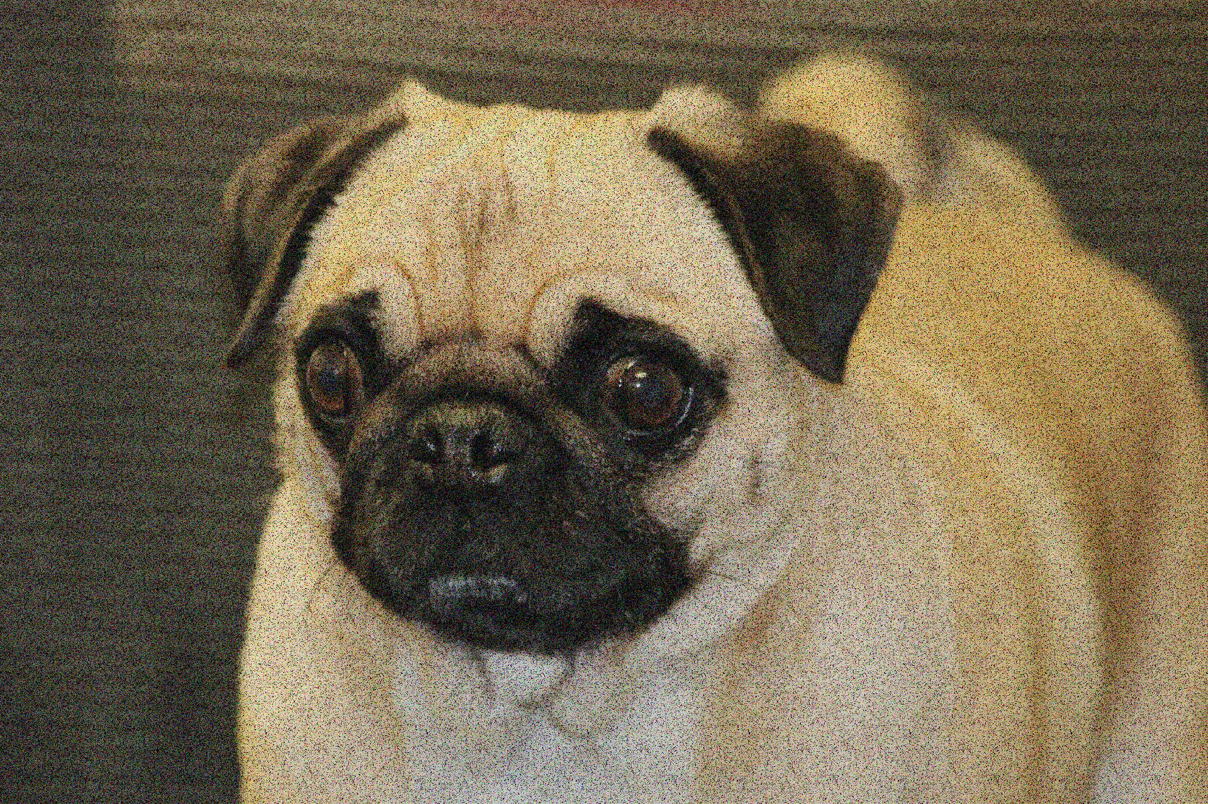
Data Augmentation
Why don’t we also flip the images vertically as well to add to the dataset? We could choose to but it reduces models performance and not necessary if the model will never see dogs walking
In the sky. But if its something like traning for satellite or aquatic life then flipping makes sense.
Data Augmentation is the process of modifying the data you already have to provide more examples to the network.
Common techniques include
  Random cropping and scaling
  Mirroring horizontally
  Adding noise

Slide 11
Whiteboard Discussion:
Visualizing the Whole Pipeline
Datasets
Data Loaders
Data Transformations

Slide 12

Batch Normalization
[Ioffe and Szegedy, 2015]
If we don’t normalise he batch, the model has issues converging. If the first 64 imgages were mostly bright, the curve may be skewed to the right and to the left for dark images. So normalosing these images
Makes them more consistent and the model converges fast.
“you want unit Gaussian activations? just make them so.”
consider a batch of activations at some layer. To make each dimension unit Gaussian, apply:
this is a vanilla differentiable function...
Value – mean, all divided by the standard deviation.

Slide 13
Batch Normalization
[Ioffe and Szegedy, 2015]
“you want unit gaussian activations?
just make them so.”
1. compute the empirical mean and variance independently for each dimension.
X
N
2. Normalize
D

Slide 14
Batch Normalization
[Ioffe and Szegedy, 2015]
Conv
Usually inserted after convolutional layers, and before nonlinearity.
BN
ReLU
Conv
BN
ReLU
...

Slide 15
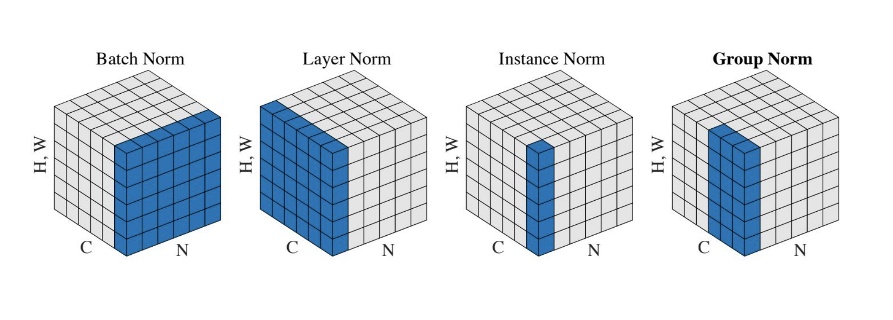
Variations on this idea

Slide 16
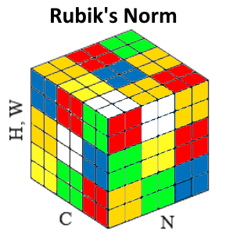
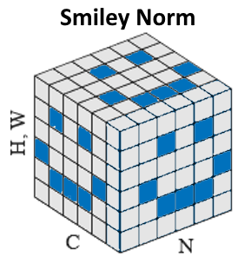
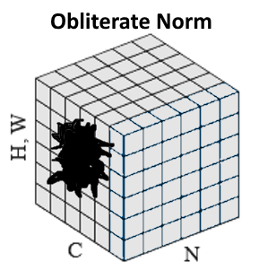
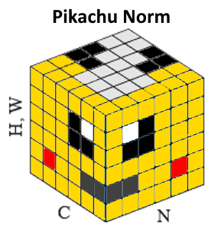
Norms I wish existed…

Slide 17



Batch Normalization
[Ioffe and Szegedy, 2015]
Normalize:
Note, the network can learn:
And then allow the network to squash
the range if it wants to:
to recover the identity mapping.

Slide 18
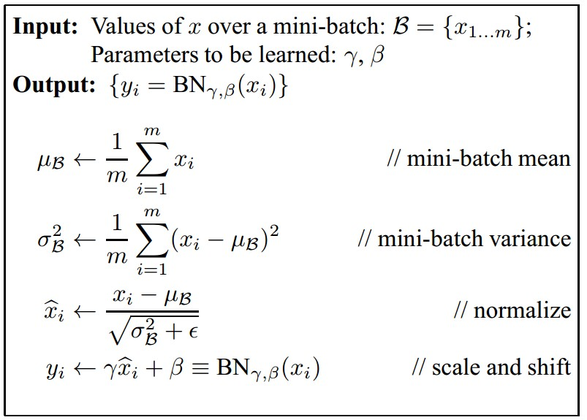
Batch Normalization
[Ioffe and Szegedy, 2015]
Improves gradient flow through the network
Allows higher learning rates
Reduces the strong dependence on initialization
Acts as a form of regularization in a funny way, and slightly reduces the need for dropout, maybe

Slide 19
Batch Normalization
[Ioffe and Szegedy, 2015]
Note: at test time BatchNorm layer functions differently:
The mean/std are not computed based on the batch. Instead, a single fixed empirical mean of activations during training is used.
(e.g. can be estimated during training with running averages)

Slide 20
Let’s Try It in PyTorch!

Slide 21
We now have a full pipeline!

Slide 22
Evaluating the Results
Metrics
Confusion Matrix

